Slide 1
zoom meeting remote learning 25.1.21

Slide 2
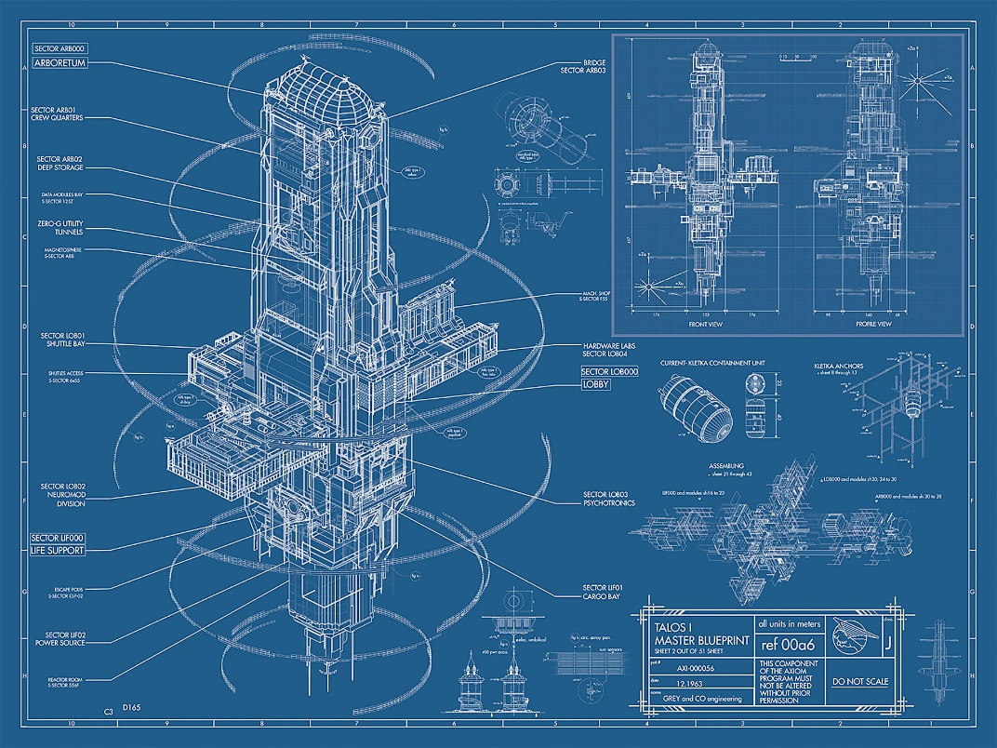
Outline for tonight’s meeting
Acknowledge our position and establish ground rules
Share what’s going well
Celebrate what families have achieved
Share survey results and next steps
Share top tips from families
Establish what next steps we need to take

Slide 3
WHEN I SAID BRING A DRINK…

Slide 4
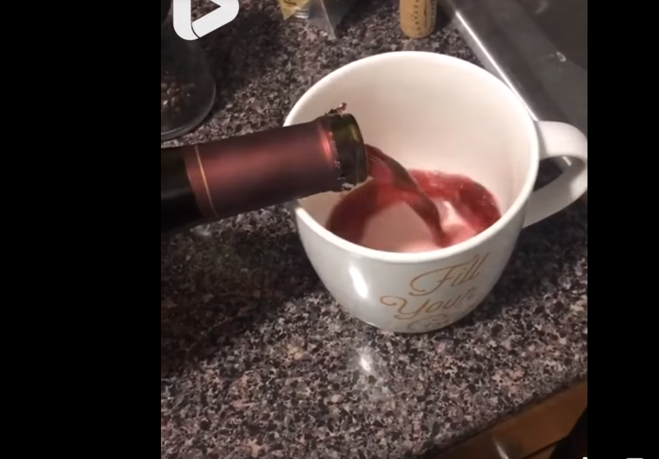
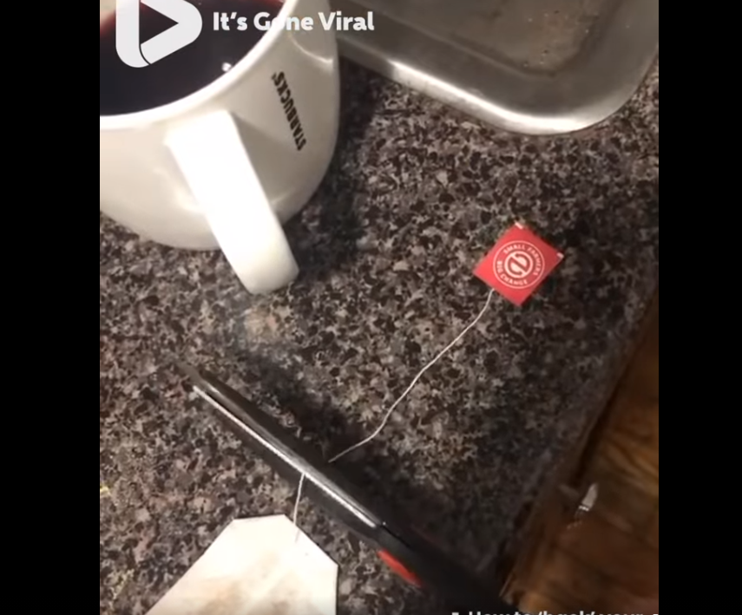
WHEN I SAID BRING A DRINK…

Slide 5
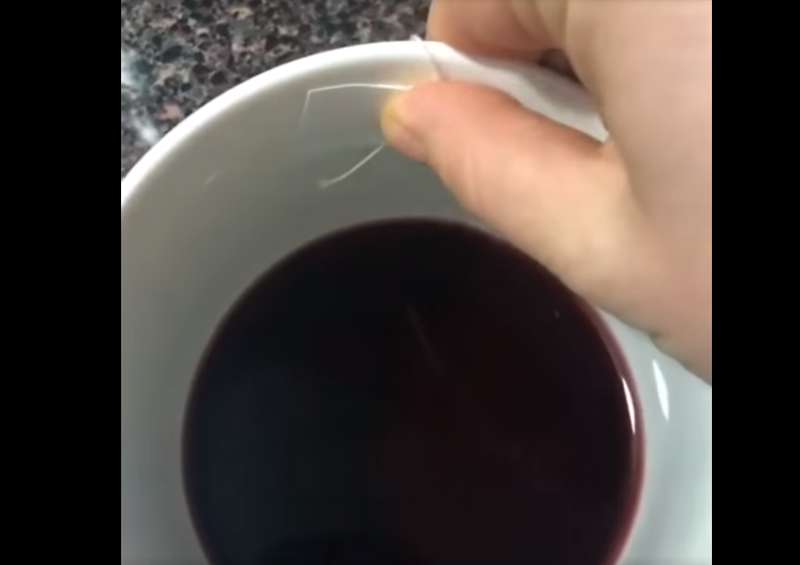
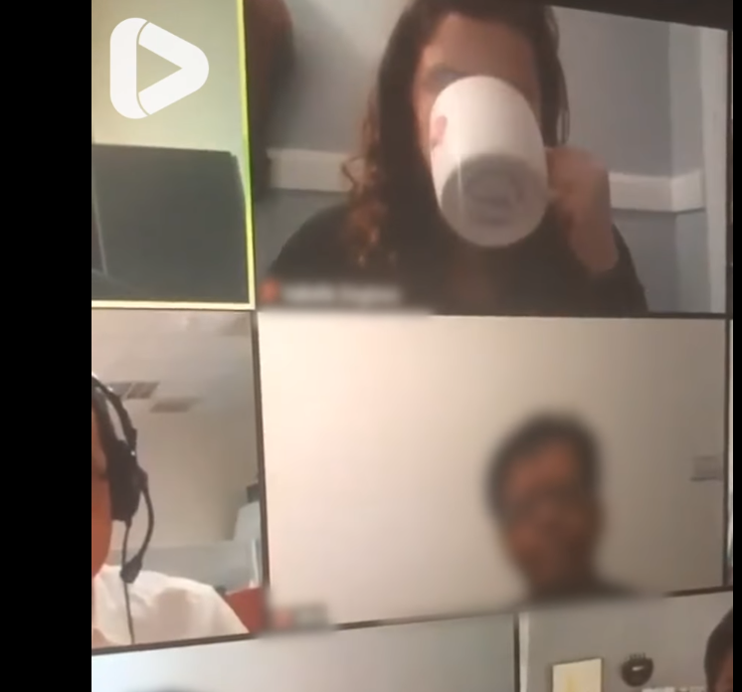

Slide 6
Ground rules
I come to tonight’s meeting mostly as a parent, not a professional
We are talking about children so they should be out of earshot!
Honesty is the best policy
We do not have all the answers as this is unchartered territory
There is a new line being formed between home and school
Families need support – families are not always perfect but they are there for each other and the Sibsey Family is no different
Your responses have been incredible and have informed next steps
There is no preaching
Parents should recognise and actively empathise with different perspectives on every point made
I will intend to record this meeting and put it on the website for parents that could not make it

Slide 7
Different perspectives
It’s really evident from the survey responses that some families have a better experience than others.
It’s also true that some people experience the best and worst within one day!
It’s impossible to list all of the different experiences going on with our families but to acknowledge just how varied and different they are is really important.

Slide 8
Remote learning plan and policy
This is on our website. We have used the government expectations and guidelines to form our remote learning plan. We have also sent this off to Lincolnshire Authority and our Engagement Steps document which has been shared with a number of other schools in the area. We feel that as a school we are setting out good practice.

Slide 9
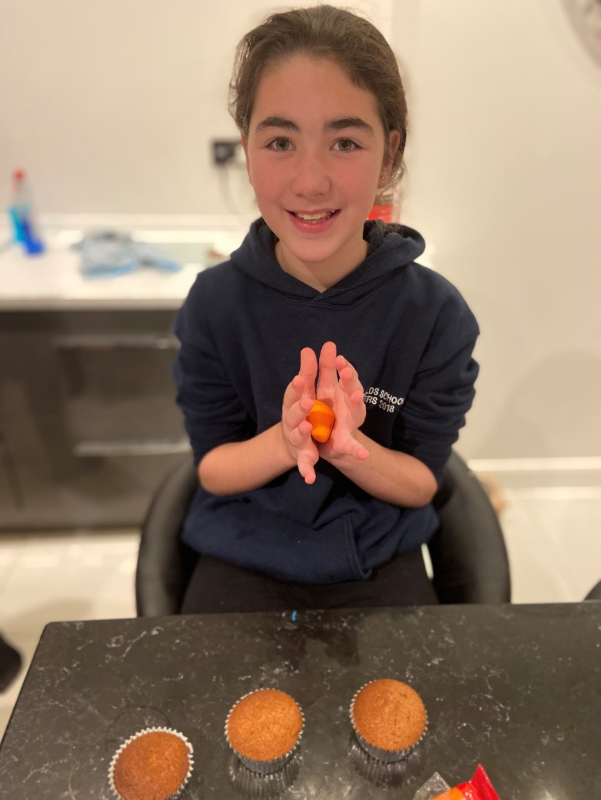
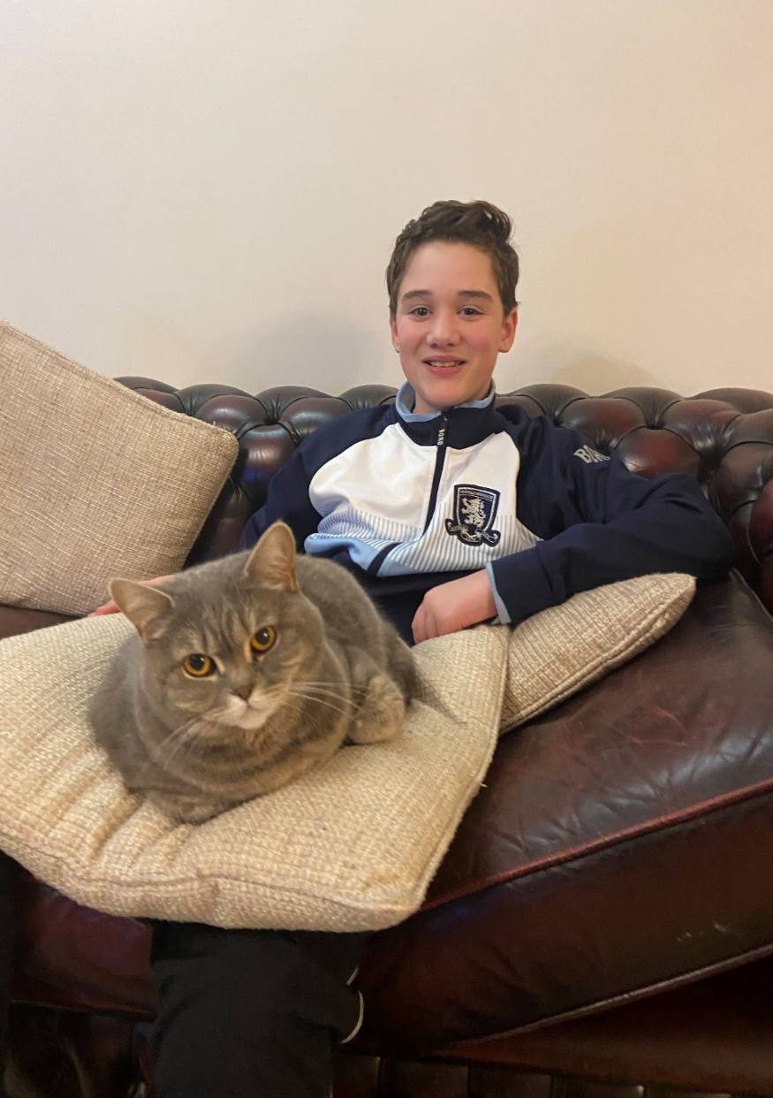

Slide 10
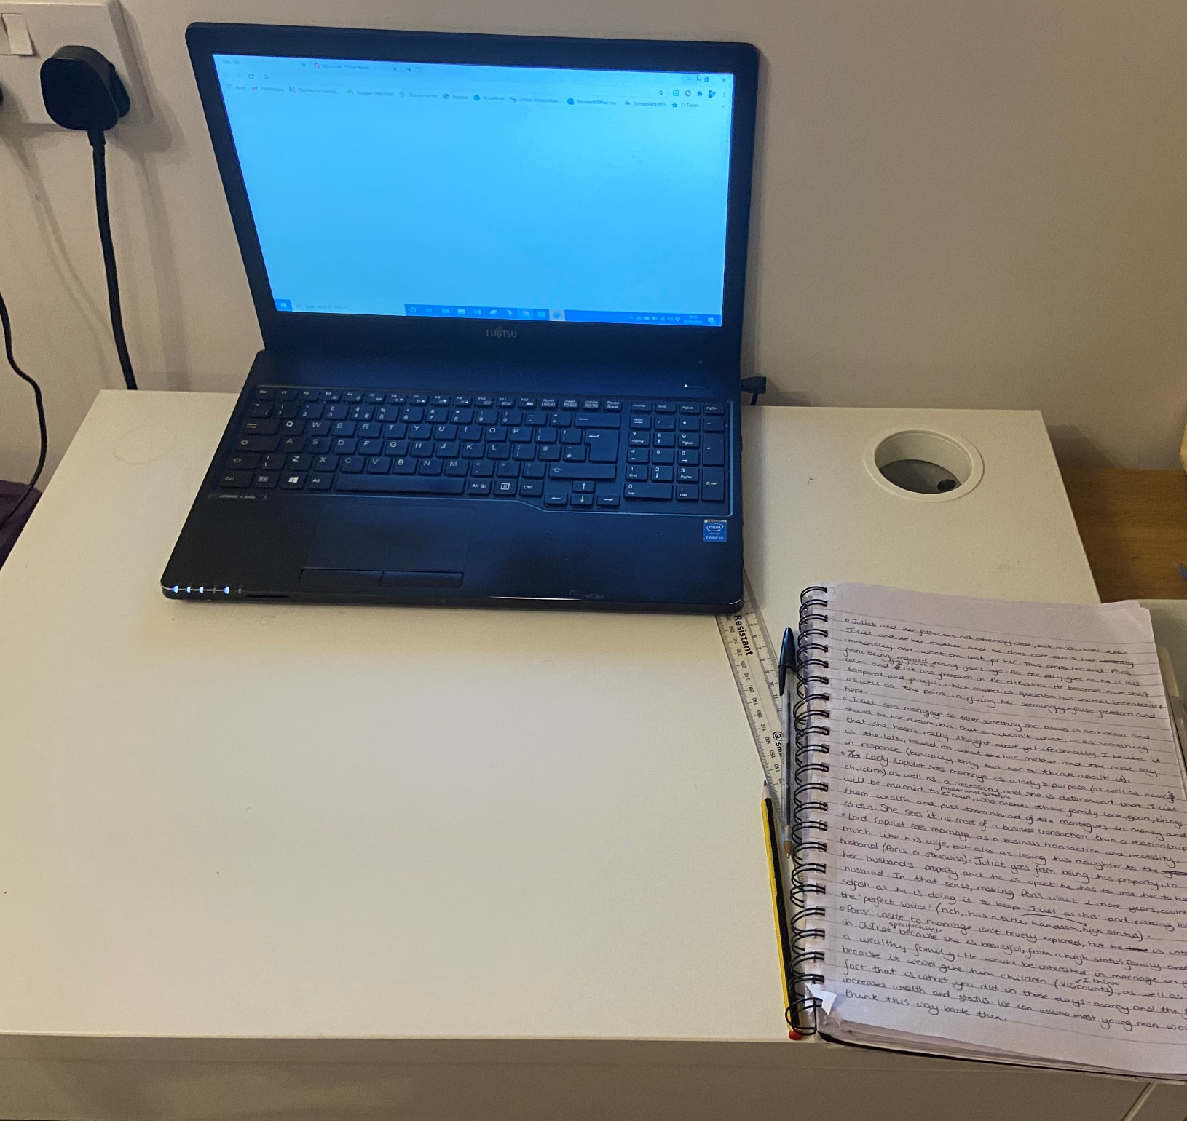
My eldest child
Izzy Year 9
Not been to school for more than a week at a time since October

Slide 11
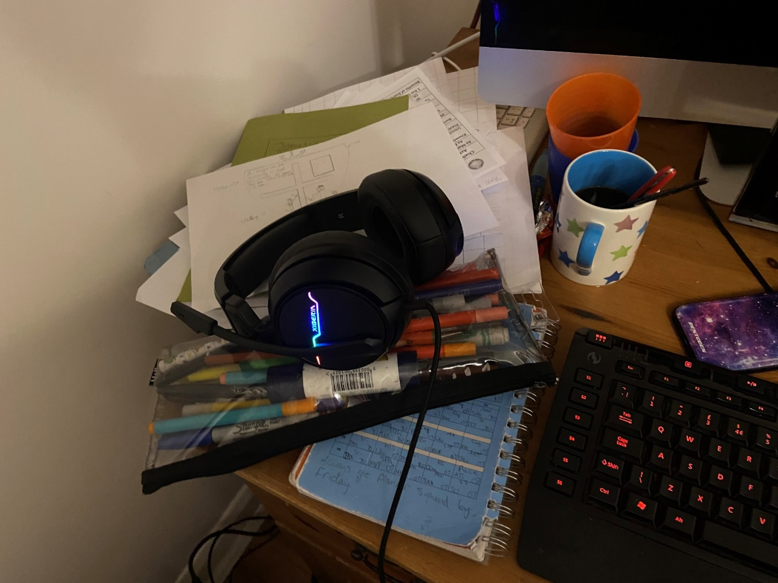
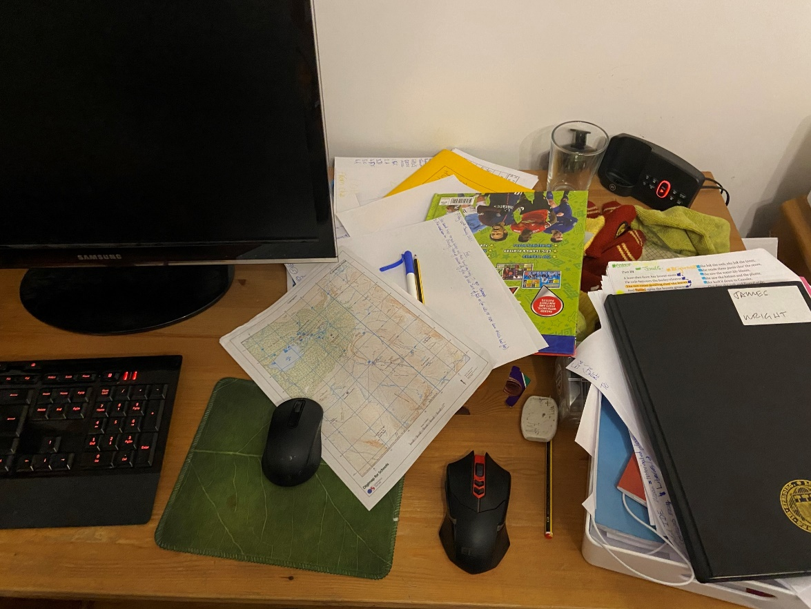
My middle child
James
Year 7
Struggled with technology like each lesson on Teams for the first week

Slide 12
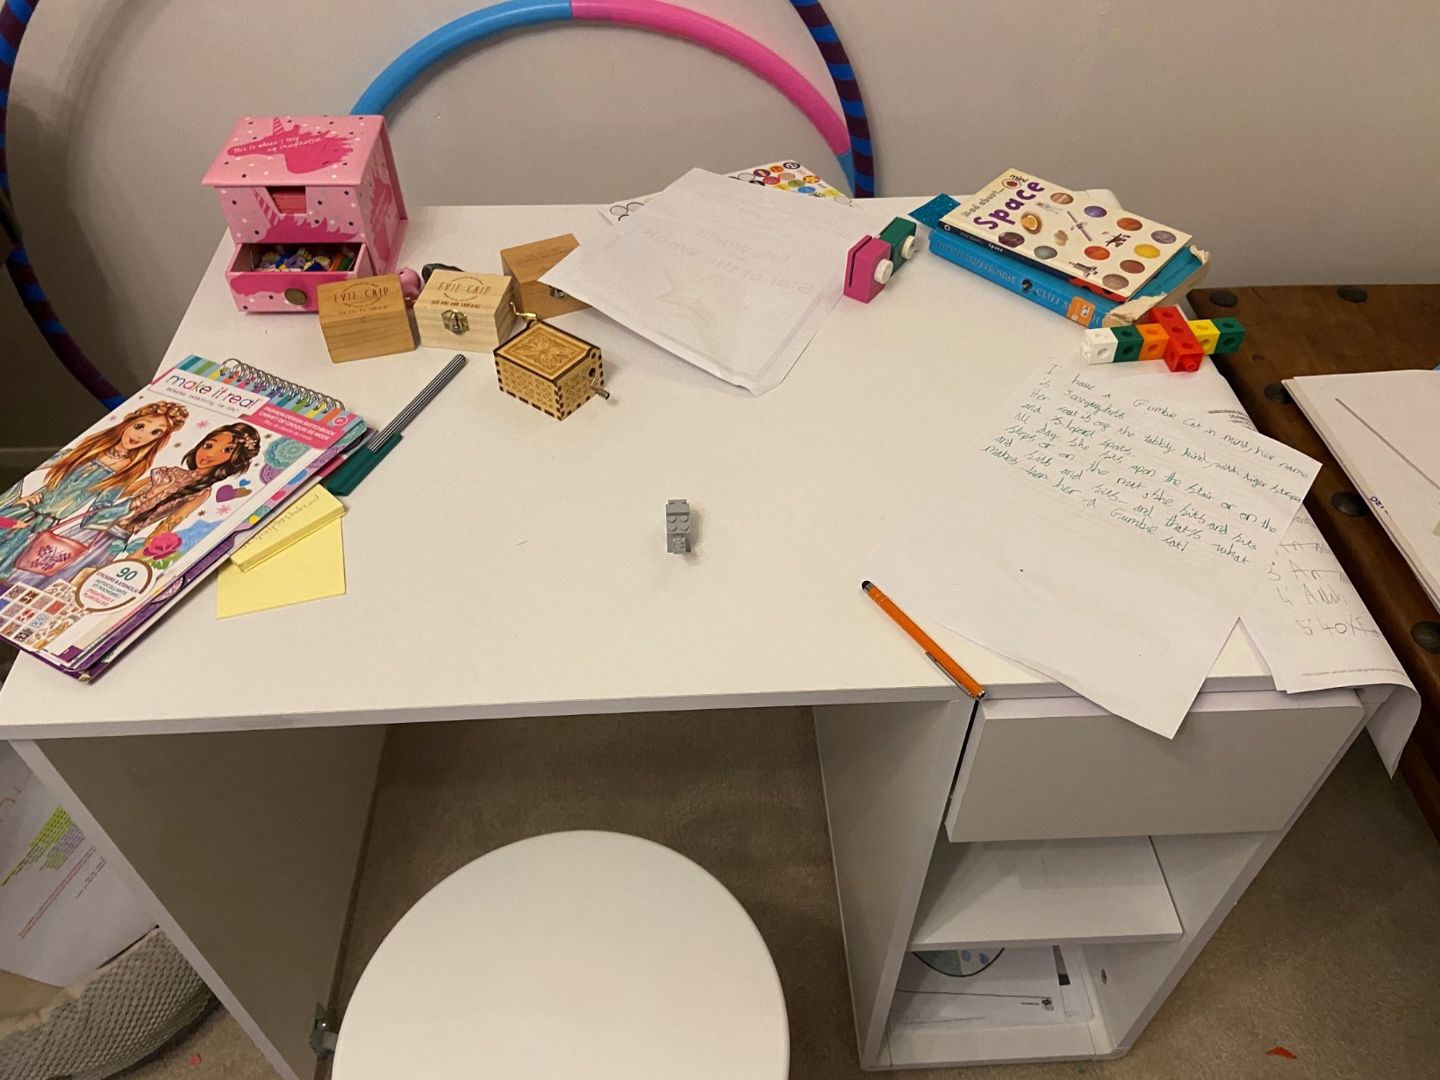
My youngest child
Evie – our little ball of chaos!
Year 4
At school but on the odd day my wife is teaching from home she has been at home.
How much evidence of quality work-related apparatus can you see at her desk?!

Slide 13
…To summarise our current feelings…

Slide 14
What September’s return to school taught us

Slide 15
What September’s return to school taught us
 | 31.9.20 (2 days) | 7.9.20 | 14.9.20 | 21.9.20
 | Entries – 24 100% at 0 | Entries – 125 88% at 0 12% at 1 | Entries – 130 85.3% at 0 14.6% at 1 | Entries – 130 97.7% at 0 3.3% at 1
 | Entries – 54 1.9% at 0 81.4% at 1 16.7% at 2 | Entries – 120 86.7% at 0 12.5% at 1 0.8% at 2 | Entries – 129 94.6% at 0 4.7% at 1 0.8% at 2 | Entries – 129 94.6% at 0 4.7% at 1 0.8% at 2
 | Entries – 56 0% at 0 76.8% at 1 23.2% at 2 | Entries – 135 0% at 0 88.9% at 1 11.1% at 2 | Entries – 135 0% at 0 88.9% at 1 11.1% at 2 | Entries – 135 0% at 0 88.9% at 1 11.1% at 2
 | Entries – 60 83.3% at 0 15% at 1 1.7% at 2 | Entries – 139 85.6% at 0 10.7% at 1 2.8% at 2 0.7% at 3 | Entries – 143 86% at 0 12.6% at 1 0.7% at 2 0.7% at 3 | Entries – 143 88.8% at 0 5.6% at 1 0.7% at 2 4.9% at 3 (2 pupils)
 | Entries – 60 83.3% at 0 15% at 1 1.7% at 2 | Entries – 143 86% at 0 12.6% at 1 0.7% at 2 0.7% at 3 | Entries – 143 86% at 0 12.6% at 1 0.7% at 2 0.7% at 3 | Entries – 143 86% at 0 12.6% at 1 0.7% at 2 0.7% at 3
 | Entries – 54 88.9% at 0 7.4% at 1 3.7% at 2 | Entries –113 88.9% at 0 7.4% at 1 3.7% at 2 | Entries – 133 100% at 0 | Entries – 133 100% at 0

Slide 16
What HAVE YOU FOUND OUT?
Children are adaptable
Children work best and they thrive when there’s predictability and structure
It helps children to feel contained and they know what is coming up next
Remind yourself that you’re not a teacher
When children are calm they are more able to learn
Looking after the basics – diet, sleep, exercise and talking

Slide 17
What’s working well?
Routine, routine, routine
Good preparation
Breaking the day into chunks
Discipline
Good use of devices
Communication – with school, with our child
Trying to increase independence even if it’s marking something

Slide 18
What’s working well?
A clear and consistent workspace
Using siblings (where possible) to motivate and keep to rules
Using siblings (where possible) in separate rooms
Reading, TTRockstars, Accelerated Reader, EdShed
Using the weekly overview
Working the best that we can
Using the Zoom call to understand the work for the day (or check up on it at the end of the day)

Slide 19
What’s working well?
Using the same structure each day
Setting our own weekly timetable
Encouraging my child to use his/her own initiative more
Once the school/work day is over, putting things away and reset for the next day
Contacting the teacher when we need support

Slide 20
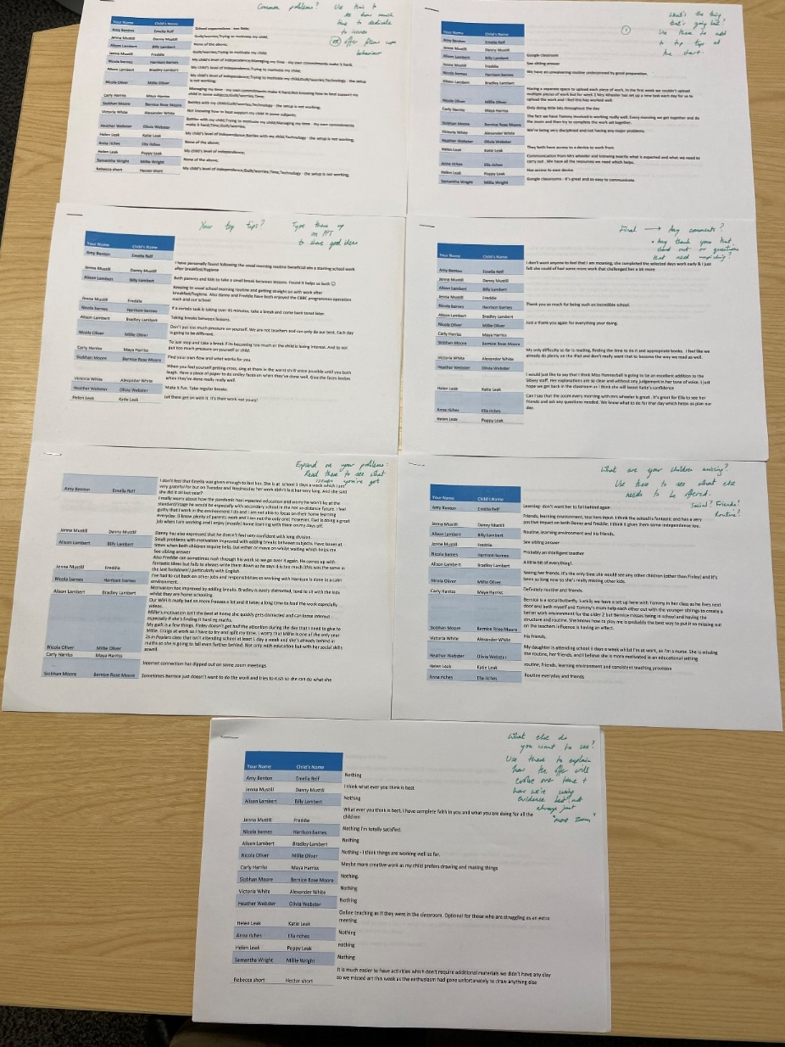
SURVEY FEEDBACK AND NEXT STEPS

Slide 21
Breakdown of Responses
SURVEY FEEDBACK AND NEXT STEPS

Slide 22
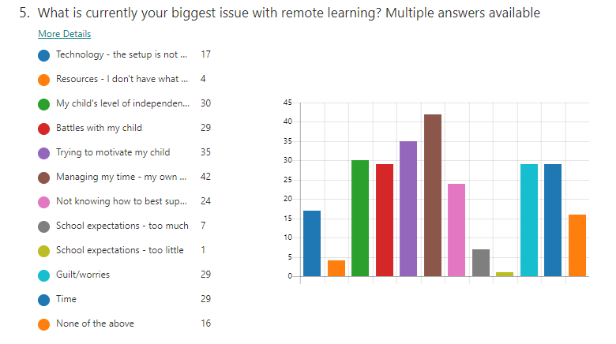
Biggest issues You are facing

Slide 23
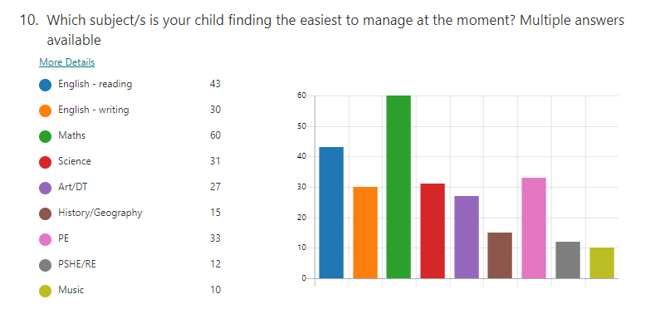
Easiest subjects to manage?
Response:
This is in line with research suggesting that recorded lessons such as White Rose is better quality than live streaming of lessons.
Next steps:
Increase in teacher inputs to go alongside Zoom sessions will adapt over the coming weeks.

Slide 24
Are tasks well explained?
Response:
Teachers have found it challenging to try to break down what they would explain in class onto a Google Classroom notification or a daily input.
Next steps:
Increased frequency of recorded inputs starting with at least one or two this week.

Slide 25
Are you receiving enough feedback?
Response:
Teachers and teaching assistants have responded to work submitted. If work is not submitted, there is no feedback. Sometimes it is delayed feedback.
Next steps:
Watch out for more voice feedback this week – children should be able to hear their adults in school using Mote on Google Classroom

Slide 26
Getting support from school?
Response:
20% have not needed it yet. 7% get some of the support they need.
70% get all the support they need.
Next steps:
We have evaluated that our support network is clear and established. Phone calls, emails, Google Classroom messages all available and responses are nearly 100% within 48hour target

Slide 27
Your top tips for each other
If you feel yourself getting cross, sing in the most shrill voice until you both laugh
Reward your child appropriately
Convince yourself that you’re doing well even on the hard days
FaceTime friends and family
Sneak a cheeky chocolate in!
Focus on what is really achievable for your child and family as a whole
Be patient
Acknowledge how different the learning methods are to when we were at school
Don’t try and get other jobs done at the same time, you’ll just get frustrated

Slide 28
Your top tips for each other
Following the morning routine of school as much as possible starts things off well
Little breaks between sessions helps both parties!
If a task is taking too long, stop and come back to it or draw a line under it
Don’t put too much pressure on yourself
Each day is going to be different
Don’t put too much pressure on your child
Find your flow and what works well for you

Slide 29
Your top tips for each other
Keep calm and keep to schedule
Use grandparents or other family members on Zoom to share the load
Realistically manage your personal expectations, know when the heat is getting too much
Do what you are capable of, arguing with your child benefits nobody
Go with the flow
Be willing to learn alongside your child
Feel that you have accomplished something each day
Make the best use of the time – if mornings work best, get it all done then!

Slide 30
Your top tips for each other
Don’t let home schooling come between you and your child
This is only temporary
Enjoy the extra time you are getting with your child
Make a plan for the day and try to stick to it
Stay true to your word
Don’t offer consequences that you won’t follow through with
Find the pattern – get the least favourite bits out of the way first or vice versa
Mimic the routine and structure of school

Slide 31
Your top tips for each other
Keep going and do your best
Be prepared and have the equipment ready
Read the instructions the teachers send you and if you’re not sure, ask!
Be kind to yourself
Plan your day the night before
Smile and nod, smile and nod (repeat)
Preparation is key – if you know what is coming up, you’re best placed to help
Involve your child in the decision making process, they’re more likely to be responsive if they are making decisions about the order of work

Slide 32
Your top tips for each other
Don’t allow the pressure of this situation to become a pressure that your relationship cannot endure
Patience is the key
Bribe wisely and not too often
Life skills and mental resilience are taught in many different ways so do not fret if this isn’t working perfectly

Slide 33
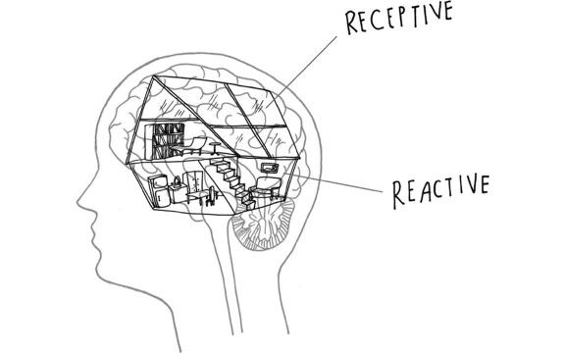
Battles with my child
https://youtu.be/2ancVyt12x4
No-drama discipline – Daniel Siegel
Teacher techniques– not doing things for the child
but helping them to do it themselves
“Don’t give them a fish, give them a fishing rod”
THIS TAKES TIME!!!
Behaviour Wall – Steve Russell

Slide 34
Talk directly about the situation
Stevie Goulding from child mental health charity Young Minds, said parents and children would benefit from following a few simple rules, such as breaking up the work, communicating clearly and stepping away from their studies occasionally.
“It’s really important to let your children know that you understand why they might be finding things difficult,” he said.
“Look for signs they might be struggling – from acting out to withdrawing or finding it hard to calm down. Let them know it’s okay to feel however they feel – whether that’s scared, worried, angry or sad. Reassure them this will pass, you’re there for them, and you’ll get through this together.”

Slide 35
A note on online safety
Worrying increase in online child abuse images and instances
These have nearly doubled since pre-lockdown
The scariest one reported, an NSPCC representative said, was a video witnessed from a child in a lovely house, involved in explicit actions and the parent called her downstairs for dinner in the middle…
Lots of digital safety awareness support on our website

Slide 36
What else Will we work towards?
More creative work and tasks
Possible upload of work at different times
PE – challenges sent out Friday for those to participate (and parents!)
Reading books
More personalised 1:1 sessions or Zoom sessions for some
Continue with the support
Reduction in screen time
Finding a way to connect friends in a non-work related manner…ideas?

Slide 37
To summarise…
Nothing is a lost cause – there are good days and bad days.
The government expectations are not “one size fits all”
We all want children back safely as soon as possible
Routine is key
Long term relationships are more important than short term battles
Find a way to make little changes to celebrate success
Be kind to yourself
Everyone is worried that their child may fall behind. Remember the whole country is feeling this.

Slide 38
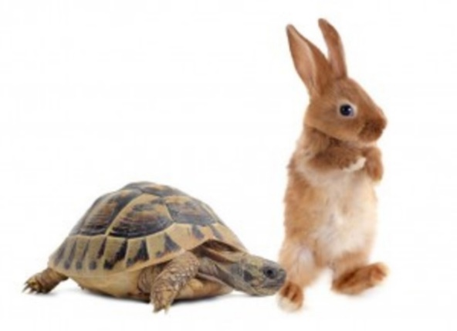
To summarise…2
Down time is hugely important
Go back to basics
There is no benefit from feeling guilty
We will continue to offer personalised support wherever possible in response to your surveys
We will take each new week at a time
We won’t make wholesale changes at once, have to be mindful of running off at 100mph vs. pacing ourselves

